Slide 1
Learning intentions and success criteria
I am learning…
I can…
About technical information about still images
How to identify information about digital images
Describe the information about digital still images
Analyse an image file to identify its information

Slide 2

Still Image Information
NPA Digital Media (Level 5)

Slide 3
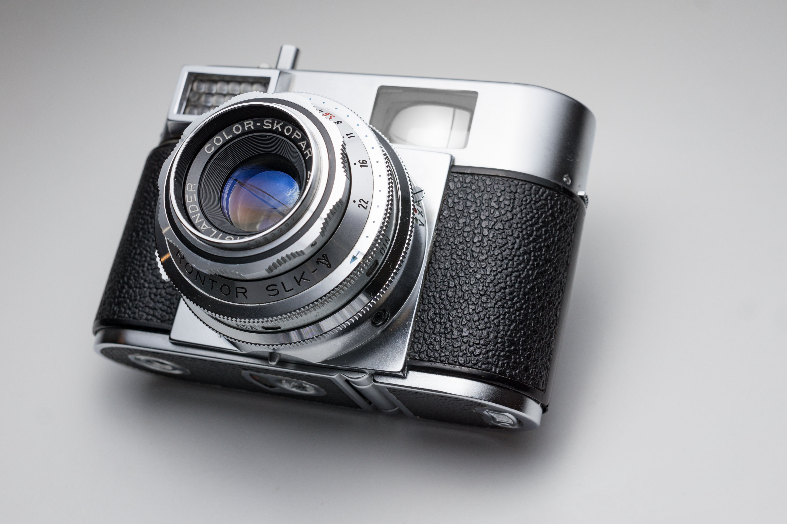
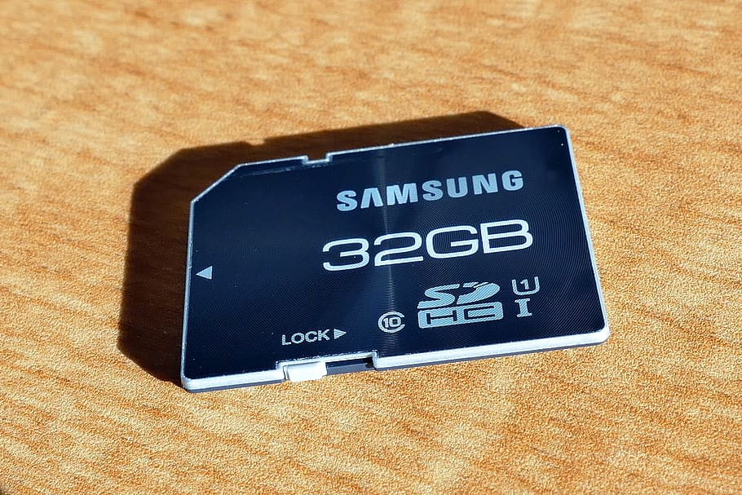

Recap
There are many devices we can use to capture, store, and process still images.
Capture devices:
Used to take or digitise images
Storage devices:
Used to store image data
Processing devices:
Used to process or manipulate images

Slide 4
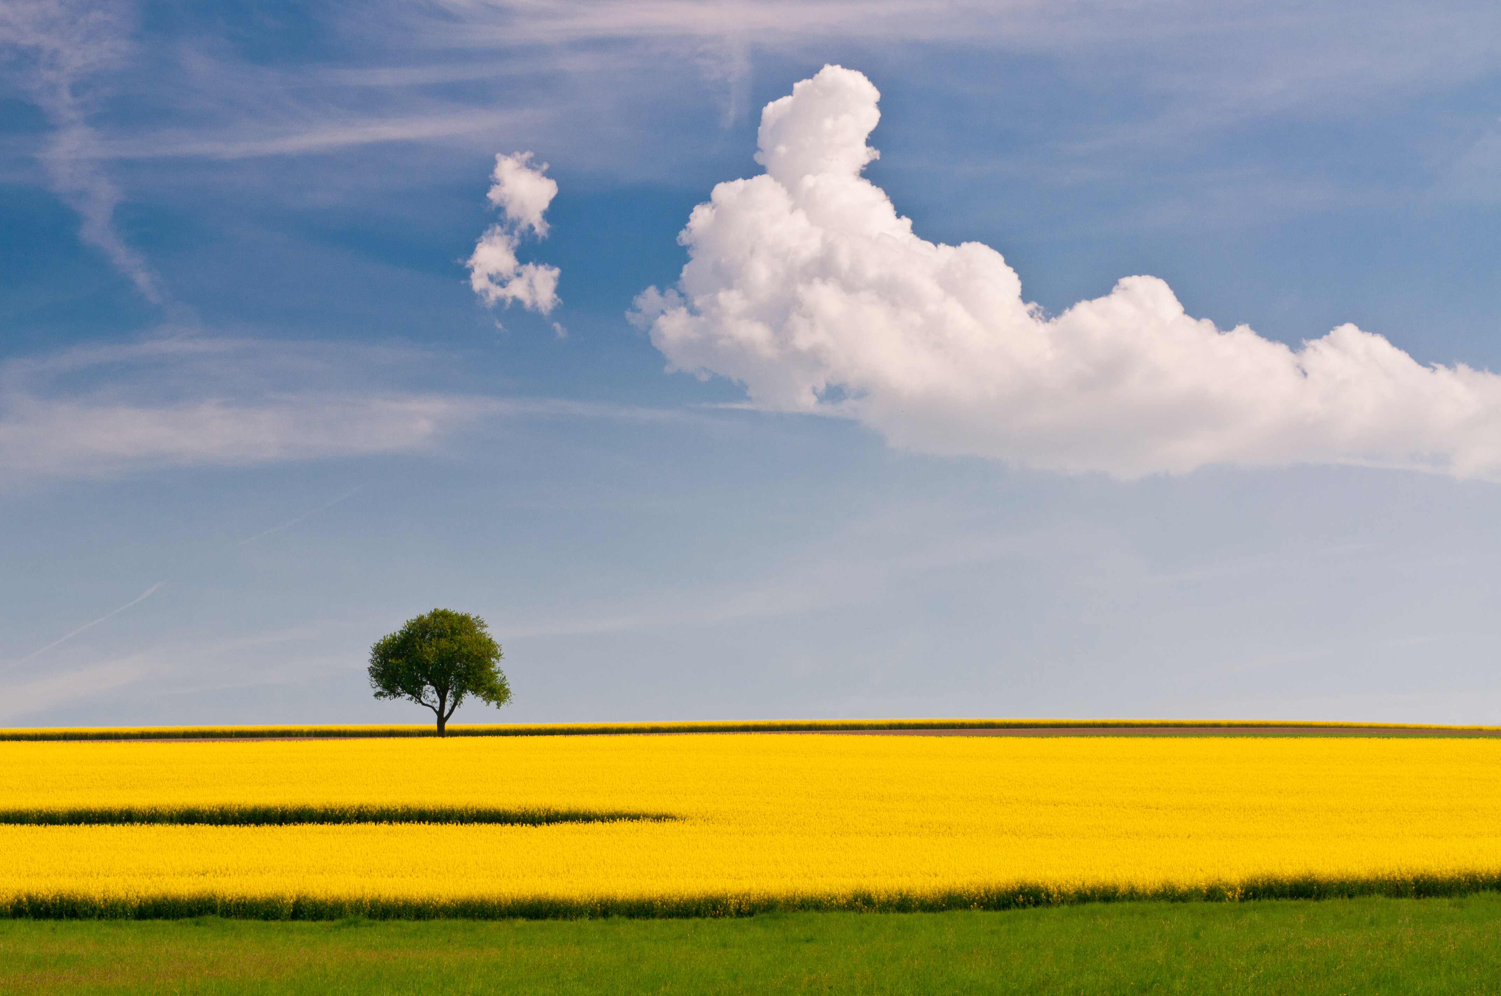
Recap
We also covered types of image files:
JPG
PNG
GIF
TIFF
RAW

Slide 5
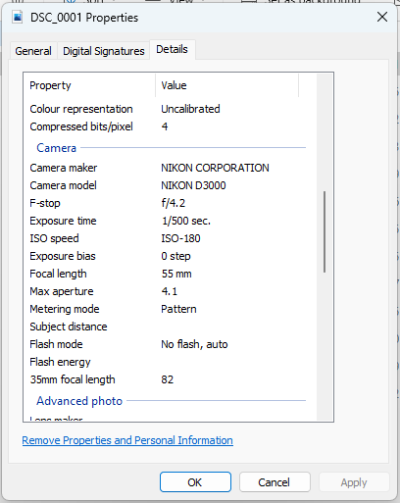
Understanding Digital Images
Digital images aren’t just pixels.
They contain information about how the image was captured and stored:
This is called Metadata
It helps photographers, editors, and software understand the technical details of the image.

Slide 6
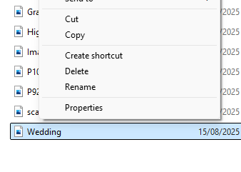
Seeing Image Metadata
To find out information about a file, you can view its Properties:
Right-click on an image file
Click Properties
Go to the Details tab

Slide 7
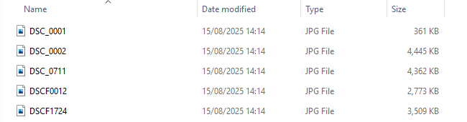
File name and Size
Each digital image file has a name and size:
What the image is called (filename)
How big the image is (usually in KB or MB)

Slide 8
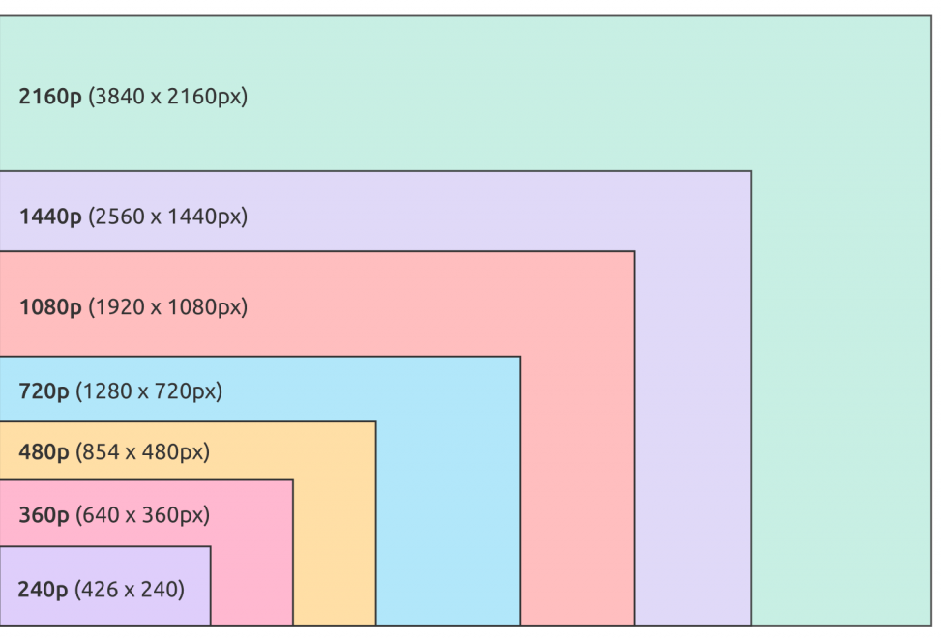
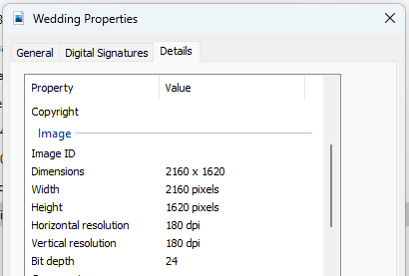
Dimensions
How many pixels tall and wide the image is:
The more pixels, the larger the image and higher the quality

Slide 9
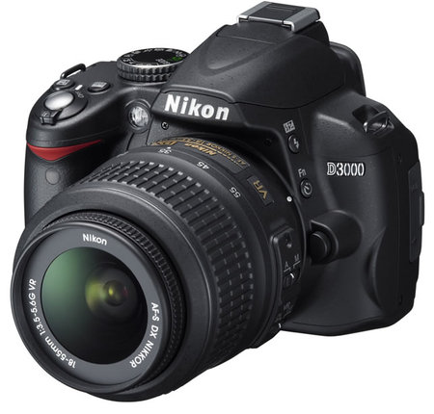
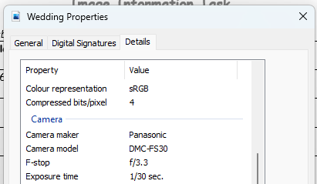
Camera Model
The Model and Maker of the camera:
For example NIKON D3000

Slide 10
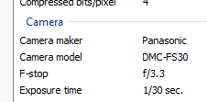
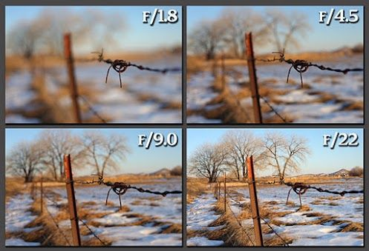
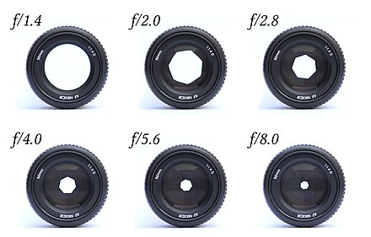
Aperture (F-Stop)
The aperture controls the depth of field.
It’s measured in F-Stops (e.g. f/2.8, f/16)

Slide 11
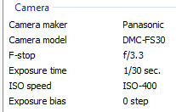
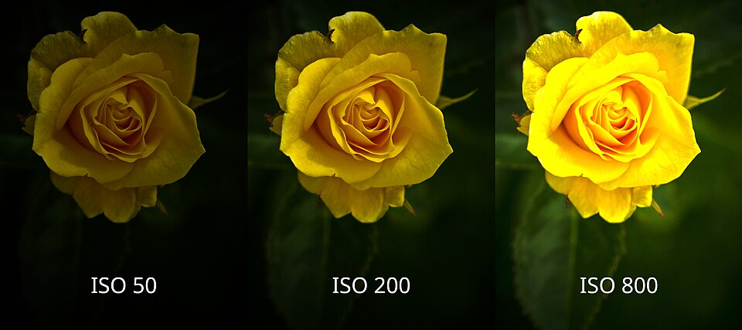
ISO Speed
The ISO is the camera’s sensitivity to light:
Measured in a Speed Number (e.g. ISO-200, ISO-3000)

Slide 12
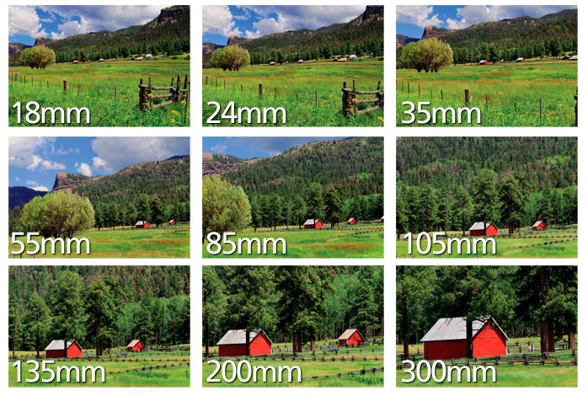
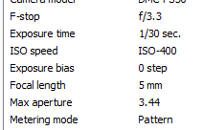
Focal Length
The distance (in mm) between the lens and the image sensor:
How “Zoomed In” the photo is
The longer the focal length, the longer the lens and the more zoomed-in the photo will be.

Slide 13
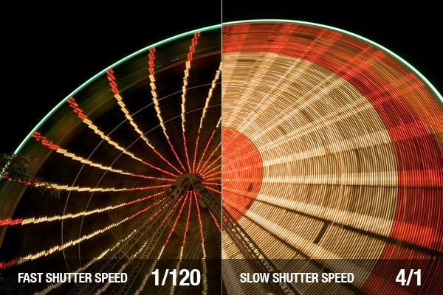
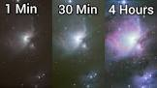
Exposure Time
How long the camera's shutter was open (in fractions of a second):
Affects brightness and motion blur

Slide 14
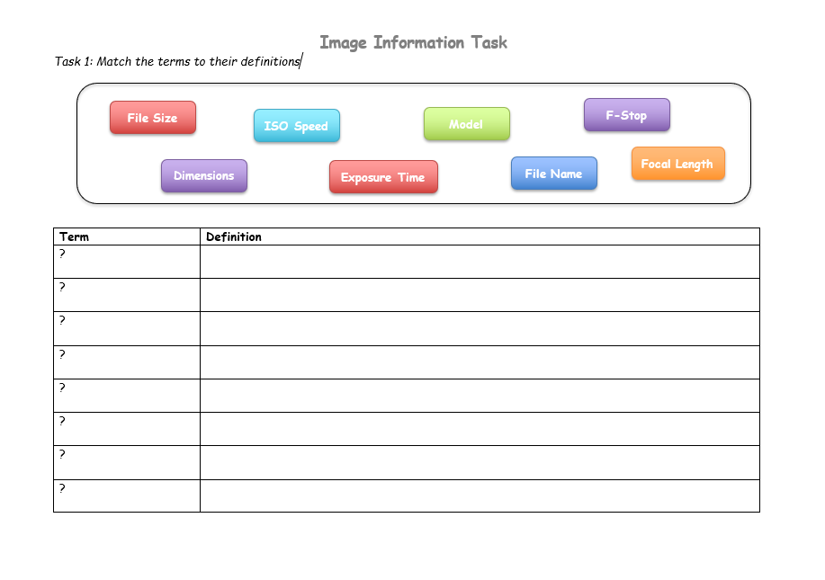
Your Task Today
Task 1: Match the definitions to the terms:

Slide 15
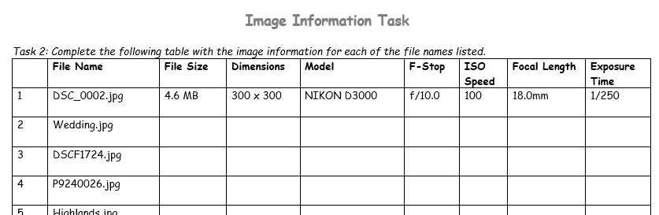
Your Task Today
Task 2: Analyse digital files and identify their information

Slide 16
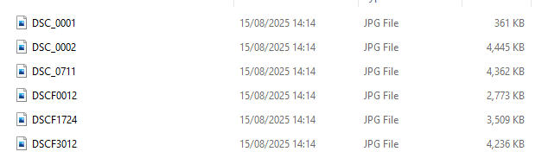
Where to find the images
Open the Our School drive in your File Explorer, then click on the folders in order:
Technologies
Computing
Departmental
Pupil
Digital Media
Still Images
Image Information Task
You should see a folder of the Images you need for today.
For each image, right-click it and click Properties then go to the Details tab.

Slide 17
Learning intentions and success criteria
I am learning…
I can…
About technical information about still images
How to identify information about digital images
Describe the information about digital still images
Analyse an image file to identify its information

